Slide 1
Cryptography
Public Key Cryptography
CSC 481/681/781
Principles of Computer Security
Notes:
asymmetric

Slide 2
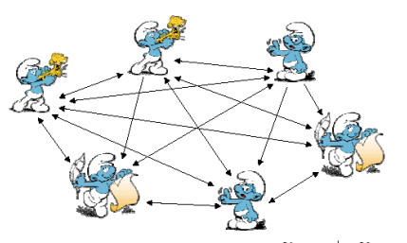
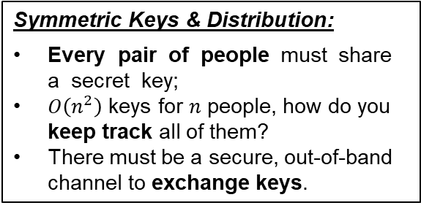
Motivation for Public Key Cryptography
Symmetric Keys & Distribution:
Every pair of people must share a secret key;
$O\left(n^{2}\right)$ keys for $n$ people, how do you keep track all of them?
There must be a secure, out-of-band channel to exchange keys.

Slide 3
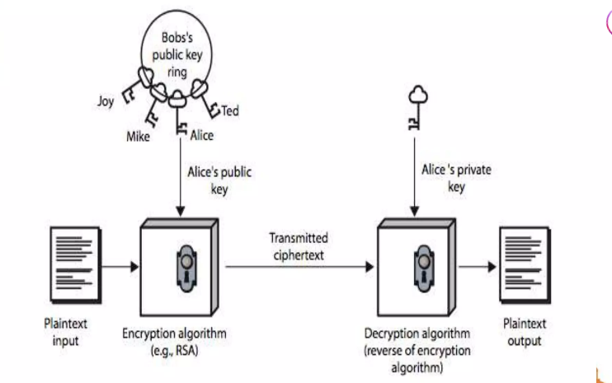
Public Key Cryptography
Public Key Cryptography : It uses two keys for encryption and for decryption.
A public-key, which may be known by anybody, and can be used to encrypt messages;
A private-key, known only to the recipient, used to decrypt messages.

Slide 4
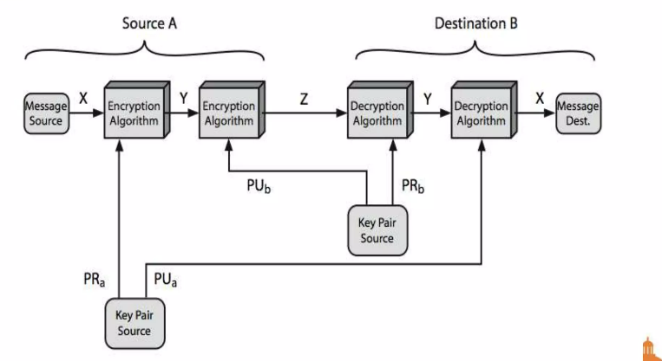
Public Key Cryptography
Public Key Characteristics :
It is computationally infeasible to find decryption key knowing only algorithm & encryption key
It is computationally easy to en/decrypt messages when the relevant (en/decrypt) key is known
Either of the two related keys can be used for encryption, with the other used for decryption (for some algorithms)

Slide 5
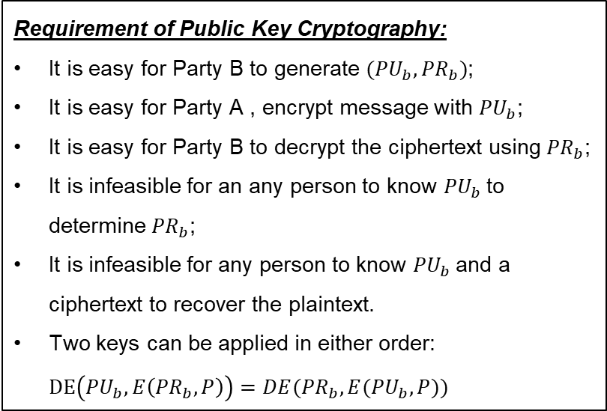
Public Key Cryptography
Requirement of Public Key Cryptography:
It is easy for Party B to generate $({PU}_{b},{PR}_{b})$;
It is easy for Party A , encrypt message with ${PU}_{b}$;
It is easy for Party B to decrypt the ciphertext using ${PR}_{b}$;
It is infeasible for an any person to know ${PU}_{b}$to determine ${PR}_{b}$;
It is infeasible for any person to know ${PU}_{b}$and a ciphertext to recover the plaintext.
Two keys can be applied in either order: $DE\left({PU}_{b}, E\left({PR}_{b}, P\right)\right)=DE({PR}_{b}, E({PU}_{b}, P))$

Slide 6
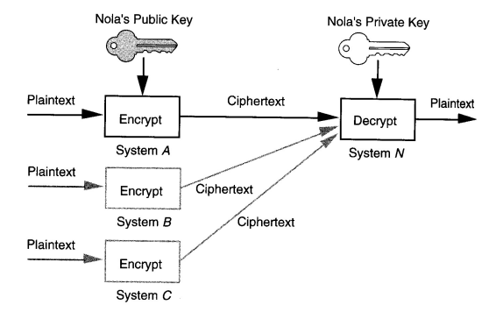
Public Key Cryptography
To send Nola a secret message:
Finds Nola’s public key, e.g. from a public directory;
Encrypting the message with public key.
Only the person who has Nola’s private key (presumably Nola’s herself) can decrypt the message successfully.
No need for secure distribution of pre-shared secret key anymore.

Slide 7
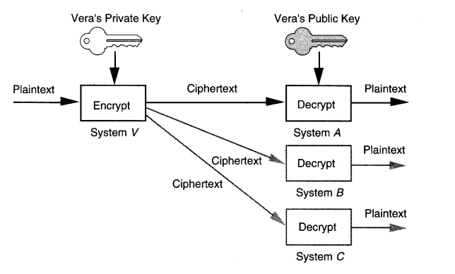
Public Key Cryptography
Digital Signature:
- If I can decrypt successfully an incoming message with Vera’s public key, the message must have been encrypted with Vera’s private key;
- Since Vera is required (e.g. by law) to keep her private key secret to herself.

Slide 8
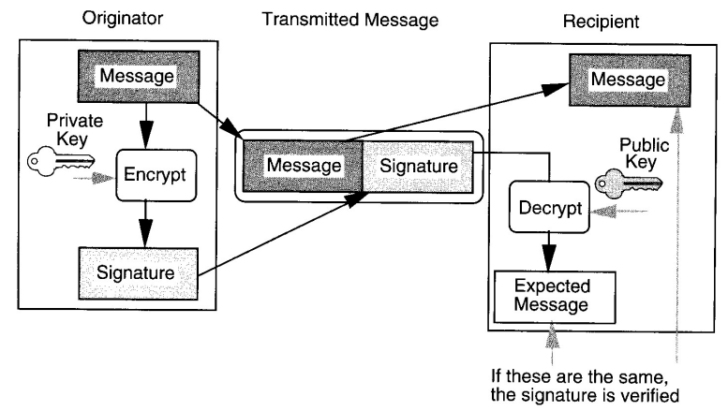
Public Key Cryptography
Public key algorithms are much slower than secret key ones. We should avoid using public key algorithms to encrypt large amount of data.

Slide 9
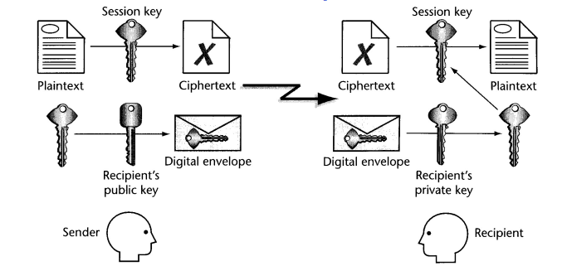
Public Key Cryptography
The sender picks a “secret” Session Key to encrypt the long message using a secret key algorithm, e.g. AES；
By encrypting the session key with the Recipient’s public key, the session key can be delivered securely to the recipient without any pre-shared secret between the 2 parties；
Conversely, we can consider this as doing a secure session-key exchange using public key encryption.

Slide 10
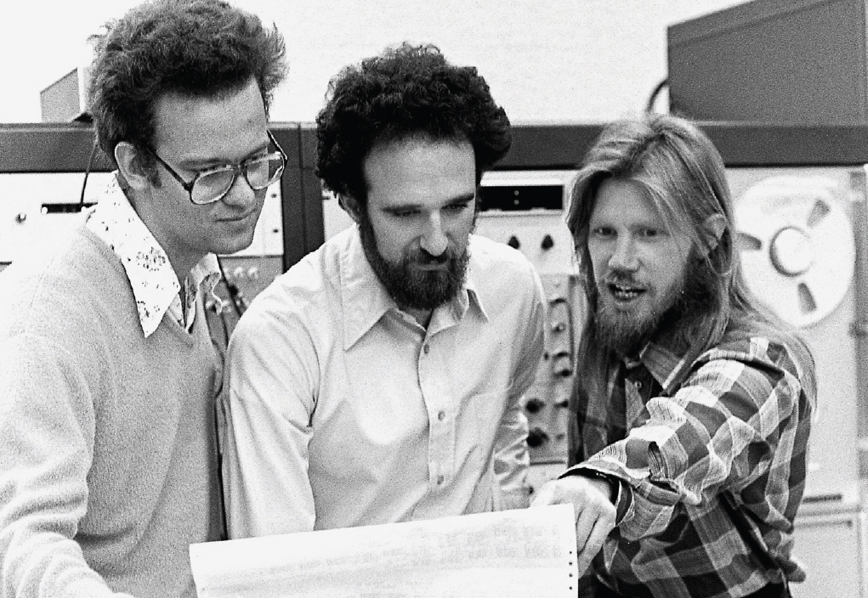
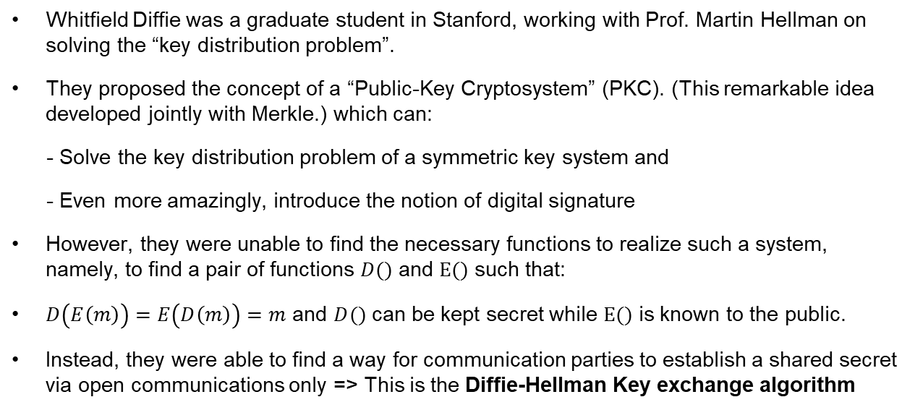
Public Key Cryptography
Whitfield Diffie was a graduate student in Stanford, working with Prof. Martin Hellman on solving the “key distribution problem”.
They proposed the concept of a “Public-Key Cryptosystem” (PKC). (This remarkable idea developed jointly with Merkle.) which can:
- Solve the key distribution problem of a symmetric key system and
- Even more amazingly, introduce the notion of digital signature
However, they were unable to find the necessary functions to realize such a system, namely, to find a pair of functions $D()$ and $E()$ such that:
$D\left(E\left(m\right)\right)=E\left(D\left(m\right)\right)=m$ and $D()$ can be kept secret while $E()$ is known to the public.
Instead, they were able to find a way for communication parties to establish a shared secret via open communications only => This is the Diffie-Hellman Key exchange algorithm

Slide 11
The Discrete Log Problem
The mathematical basis for several algorithms
For every prime number p, there exists a primitive root (or “generator”) g such that
g¹, g², g³, g⁴, …, g^{p-2}, g^{p-1} (all taken mod p)
are all distinct values (so this is a permutation of 1, 2, 3, ..., p-1).
Example: 3 is a primitive root of 17, with powers:
i | 1 | 2 | 3 | 4 | 5 | 6 | 7 | 8 | 9 | 10 | 11 | 12 | 13 | 14 | 15 | 16
3^{i} mod 17 | 3 | 9 | 10 | 13 | 5 | 15 | 11 | 16 | 14 | 8 | 7 | 4 | 12 | 2 | 6 | 1
f_{g,p}(i) = g^{i} mod p is a bijective mapping on {1,.., p-1}
f_{g,p}(i) is easy to compute (modular powering algorithm)
Inverse, written dlog_{g,p}(x) = f_{g,p}⁻¹(x), is believed to be difficult to compute
g and p are global public parameters

Slide 12
Diffie-Hellman Key Exchange (DHE)
Assume g and p are known, public parameters
Alice
a ← random value from {1, …, p-1}
A ← gª mod p
Bob
b ← random value from {1, …, p-1}
B ← g^{b} mod p
Send A to Bob
Send B to Alice
S_{a} ← Bª mod p
S_{b} ← A^{b} mod p
In the end, Alice’s secret (S_{a}) is the same as Bob’s secret (S_{b}):
S_{a} = Bª = g^{ba} = g^{ab} = A^{b} = S_{b}
Eavesdropper knows A and B, but to get a or b requires solving the discrete logarithm problem! (Getting S seems to require getting a or b)

Slide 13
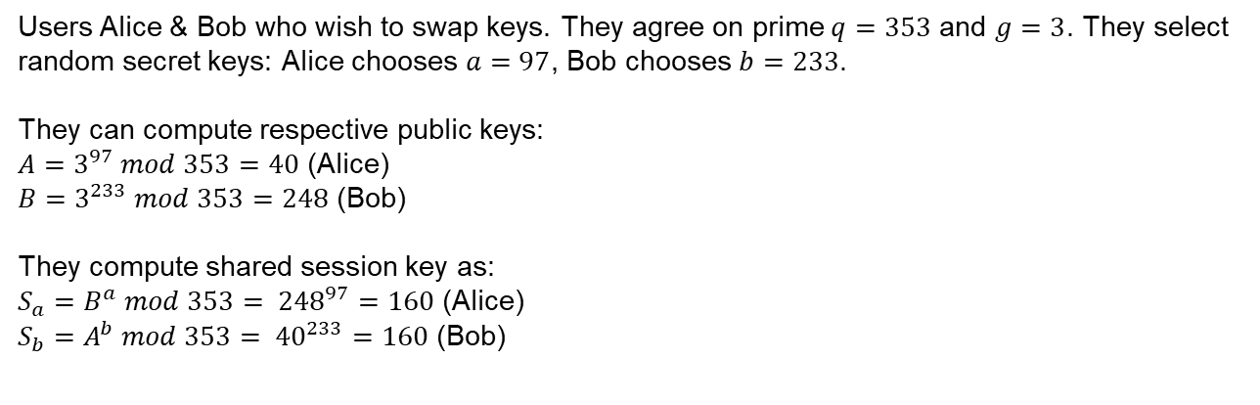
Diffie-Hellman Key Exchange (DHE)
Assume g and p are known, public parameters
Users Alice & Bob who wish to swap keys. They agree on prime $q=353$ and $g=3$. They select random secret keys: Alice chooses $a=97$, Bob chooses $b=233$.
They can compute respective public keys:
$A=3^{97} mod 353=40$ (Alice)
$B=3^{233} mod 353=248$ (Bob)
They compute shared session key as:
$S_{a}=B^{a} mod 353= {248}^{97}=160$ (Alice)
$S_{b}=A^{b} mod 353= {40}^{233}=160$ (Bob)

Slide 14
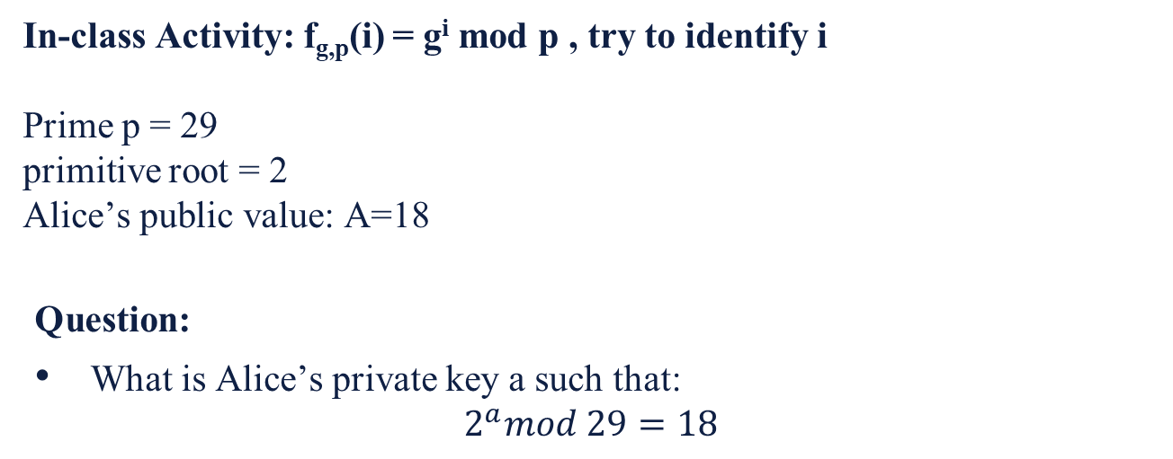
The Discrete Log Problem
The mathematical basis for several algorithms
In-class Activity: f_{g,p}(i) = g^{i} mod p , try to identify i
Prime p = 29
primitive root = 2
Alice’s public value: A=18
Question:
What is Alice’s private key a such that:
$$2^{a}mod 29=18$$

Slide 15
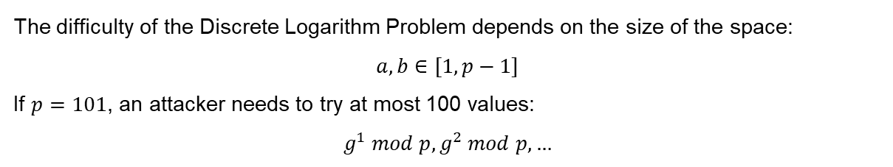

Diffie-Hellman Key Exchange (DHE)
Assume g and p are known, public parameters
The difficulty of the Discrete Logarithm Problem depends on the size of the space:
$$a,b∈[1,p−1]$$
If $p=101$, an attacker needs to try at most 100 values:
$$g^{1} mod p,g^{2} mod p, …$$
How large does p need to be to be secure?
Security level | Minimum p size
Outdated | 1024 bits
Standard secure | 2048 bits (today’s HTTPS)
High security | 3072–4096 bits
Very high | 8192 bits
$$≈ {10}^{616}$$

Slide 16
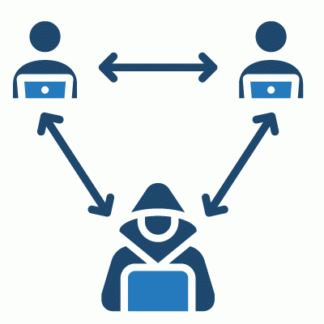
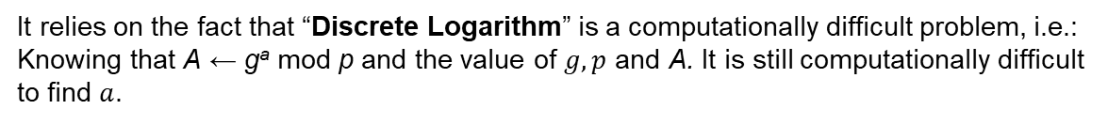
Diffie-Hellman Key Exchange (DHE)
How secure is Diffie-Hellman Key Exchange ?
It relies on the fact that “Discrete Logarithm” is a computationally difficult problem, i.e.:
Knowing that A ← gª mod p and the value of $g, p$ and A. It is still computationally difficult to find $a$.
But still subject to Man-in-the-Middle Attack !! Because Alice does not know for sure if it’s actually Bob who is sending her the $B$.

Slide 17
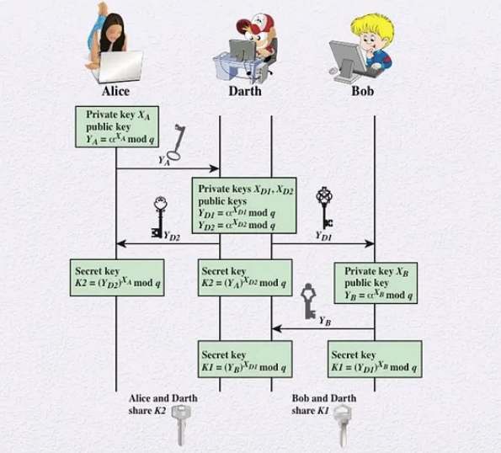
Diffie-Hellman Key Exchange (DHE)

Slide 18
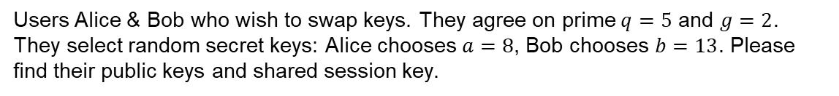


Diffie-Hellman Key Exchange (DHE)
Test your understanding…
Users Alice & Bob who wish to swap keys. They agree on prime $q=5$ and $g=2$. They select random secret keys: Alice chooses $a=8$, Bob chooses $b=13$. Please find their public keys and shared session key.
$$A=2^{8} mod 5=1$$
$$B=2^{13} mod 5=2$$
$$S_{a}=S_{b}=2^{8} mod 5= 1^{13} mod 5=1$$

